Slide 1
Reduce integration complexity with aggregated data services
Middleware Products:
JBoss Data Virtualization 6
Apache Camel 2.14

Slide 2
Red Hat JBoss Data Virtualization with Integrated Demonstration

Slide 3
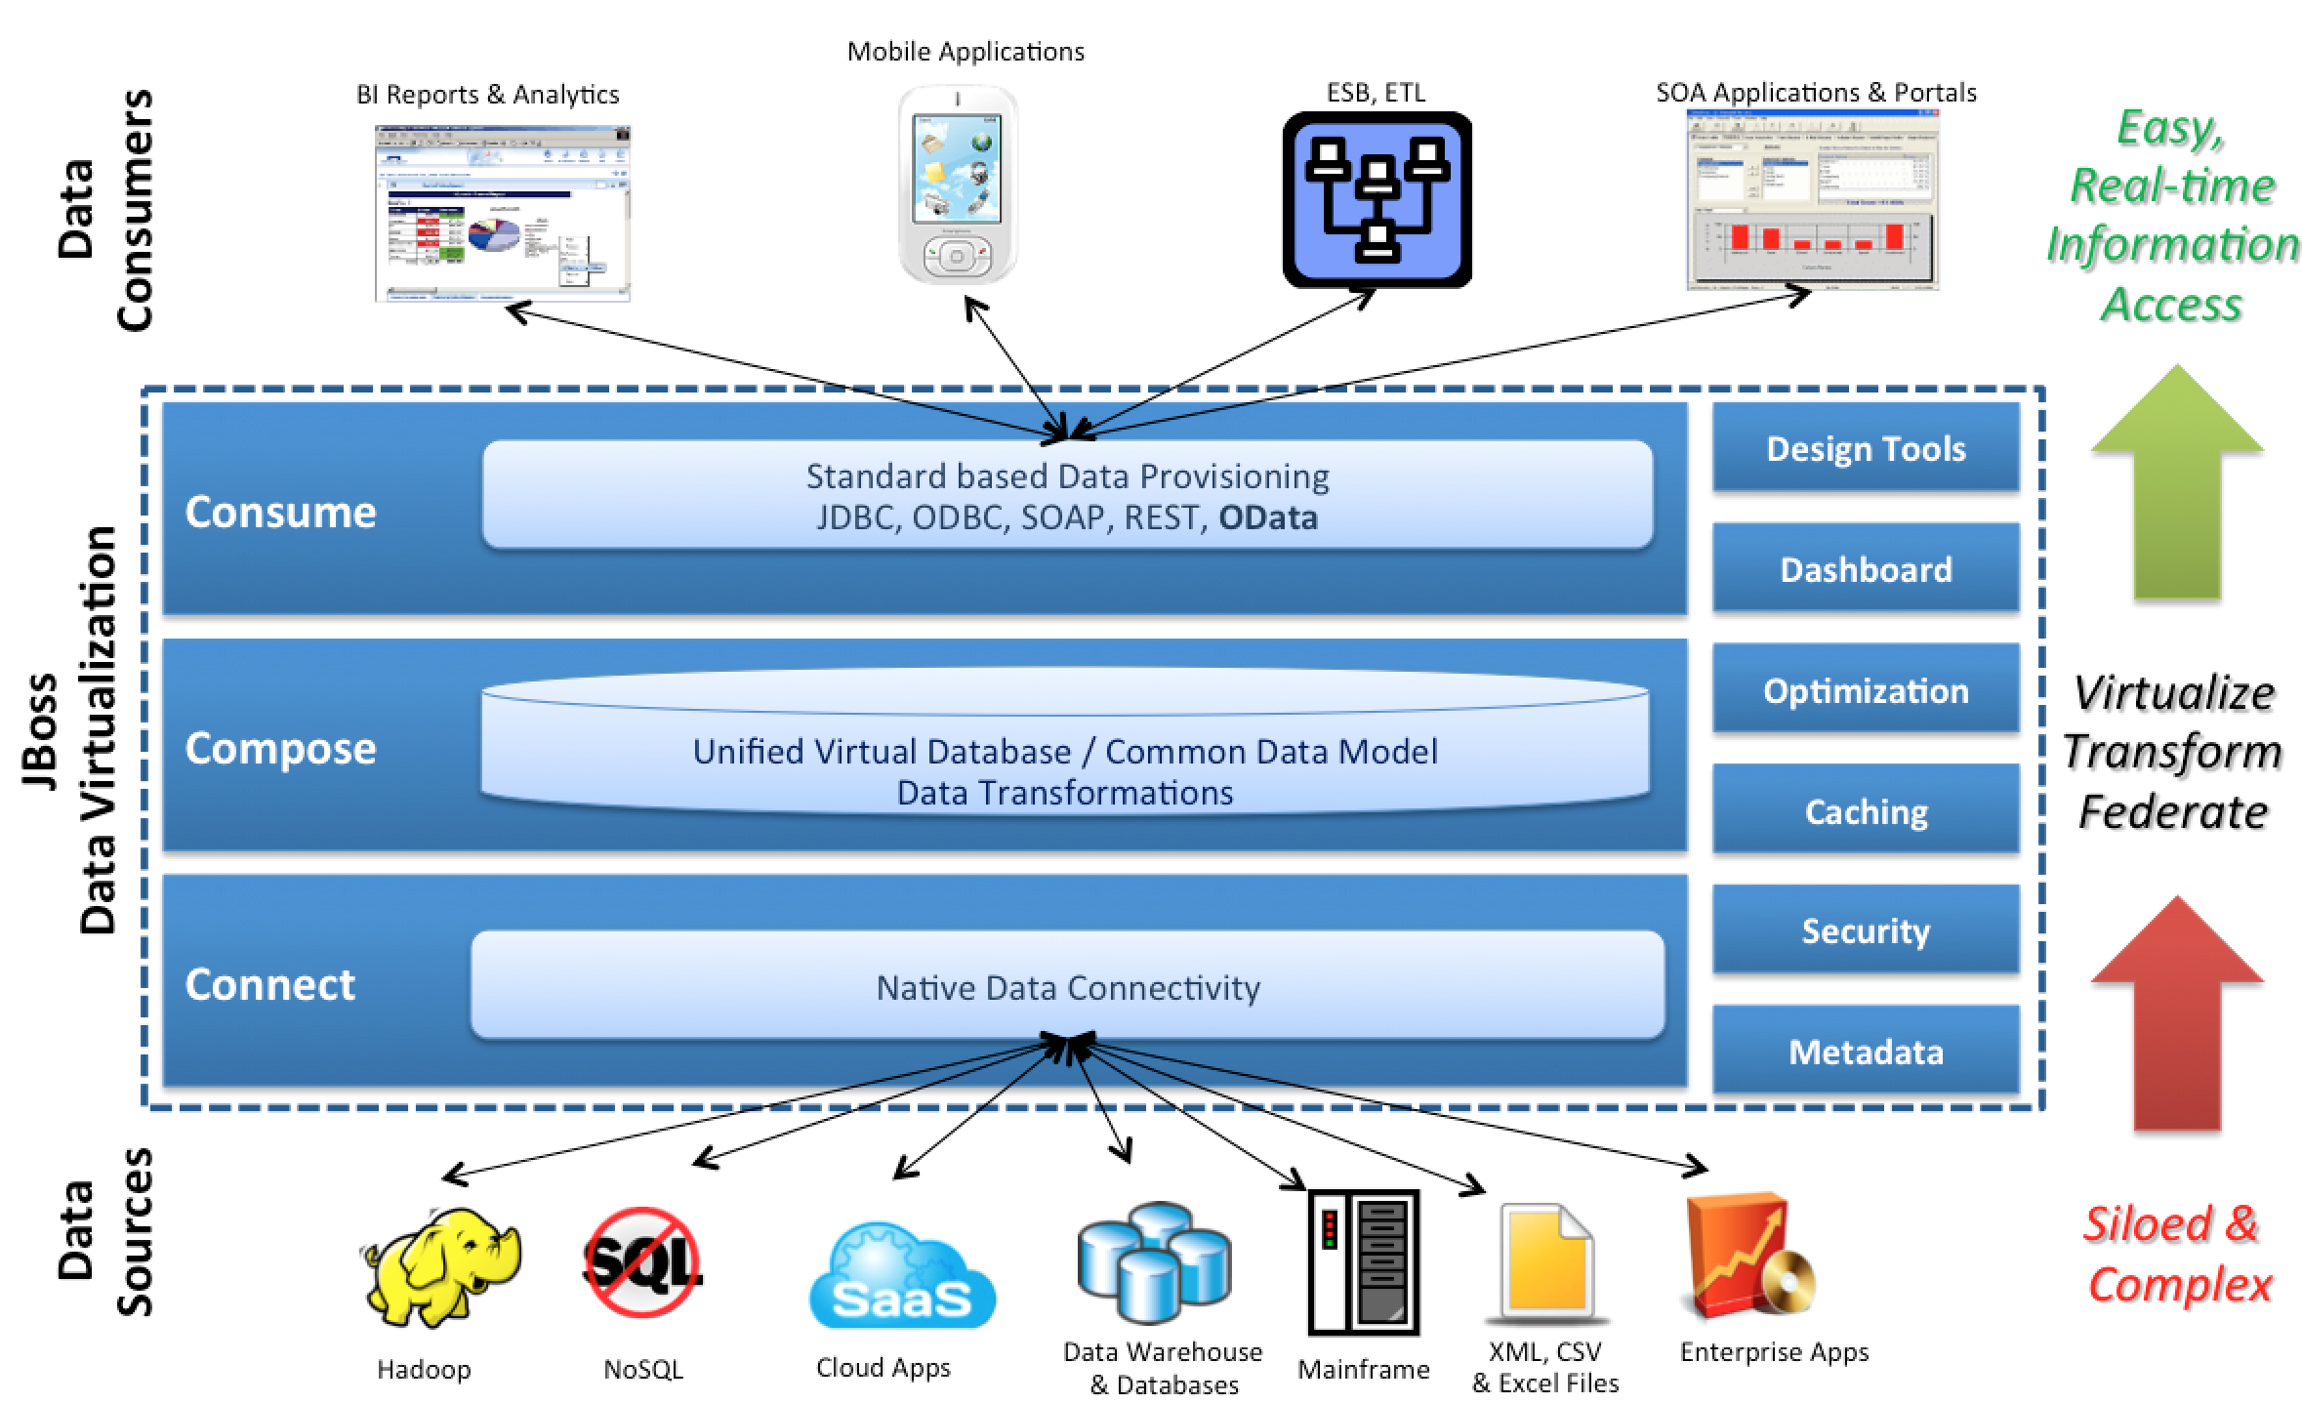
Introduce Red Hat JBoss Data Virtualization

Slide 4
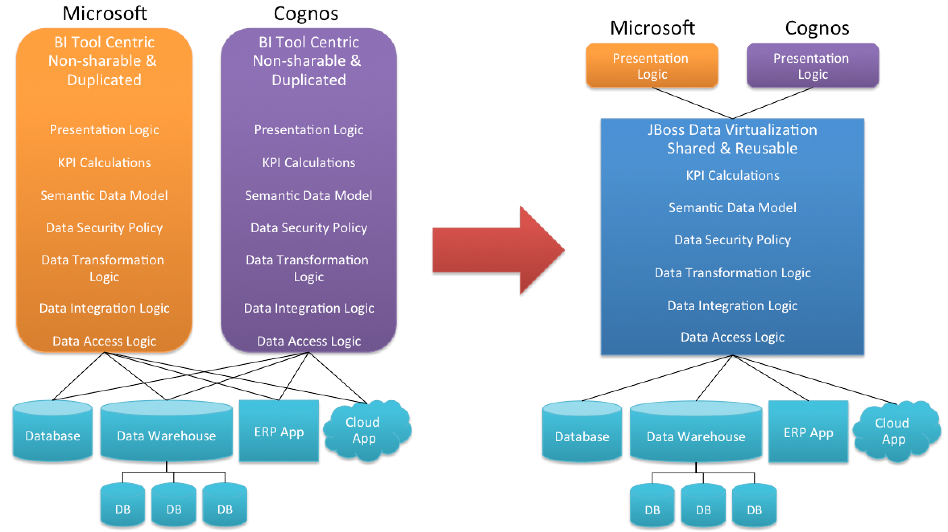
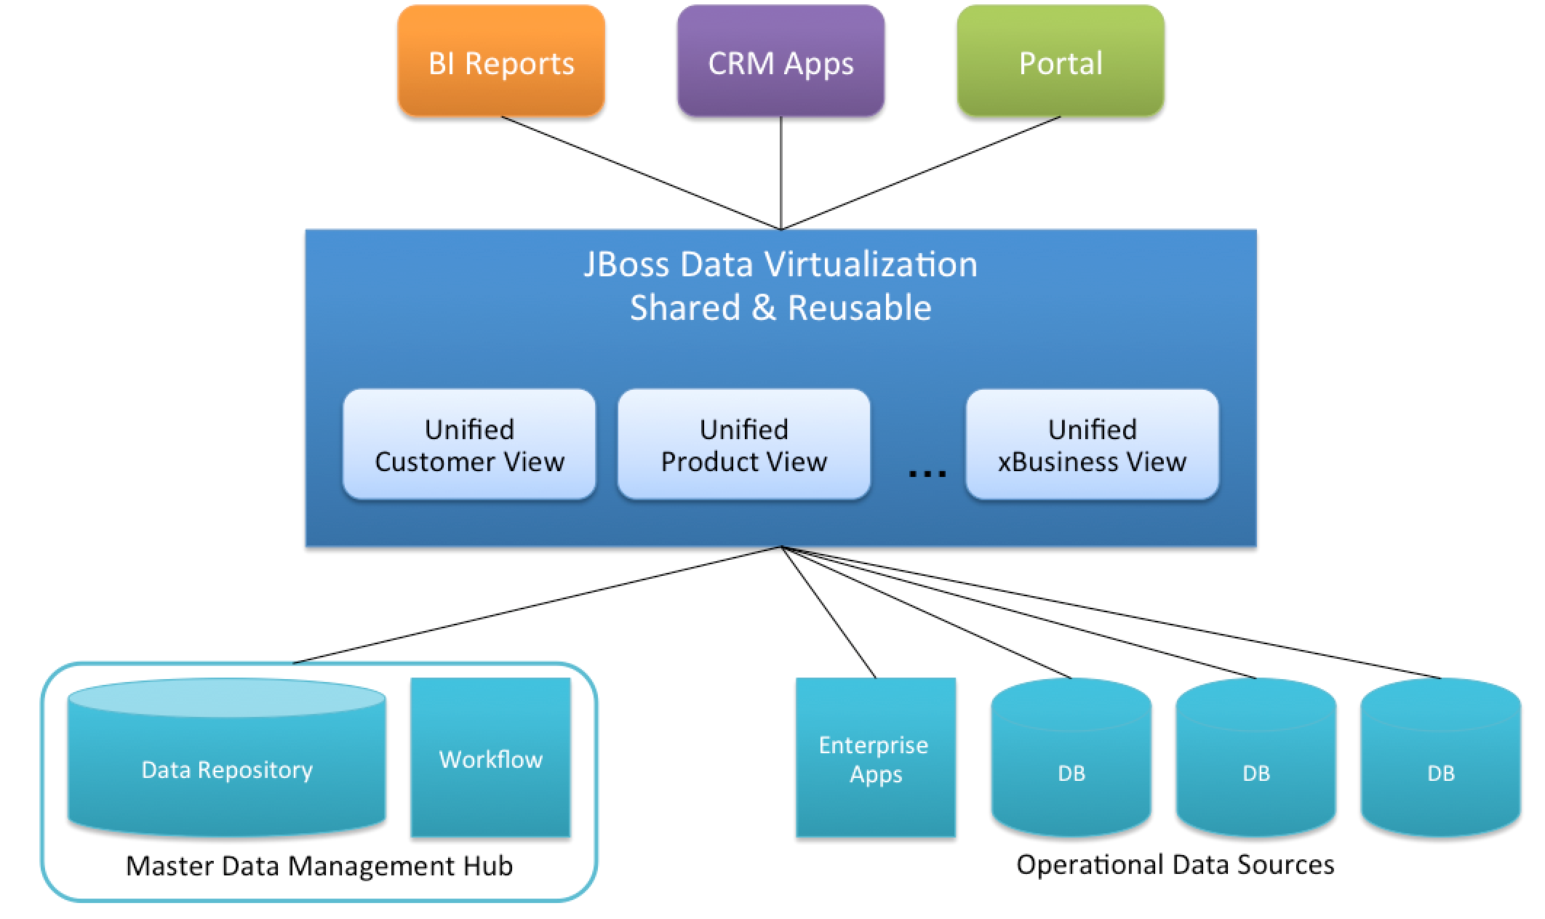
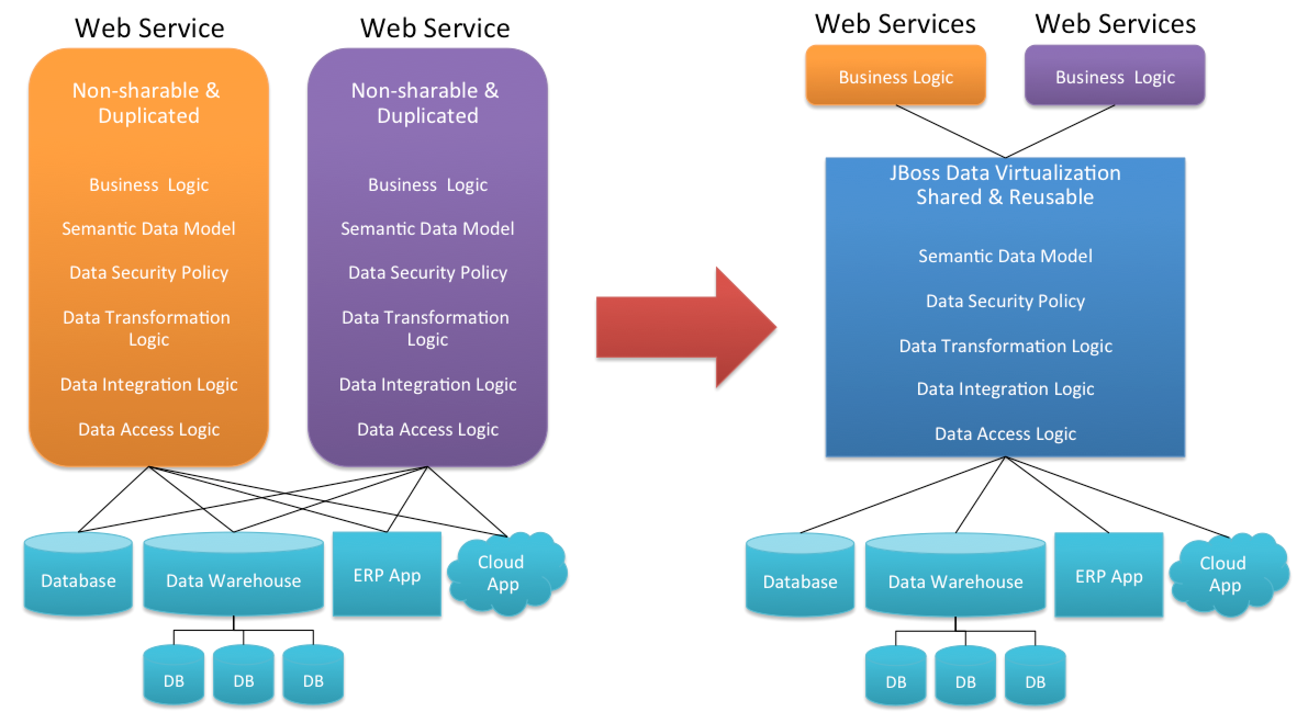
JBoss Data Virtualization Use Cases
Regulatory Compliance
Self-Service Business Intelligence
360 degrees Unified Views
Agile Data Services

Slide 5
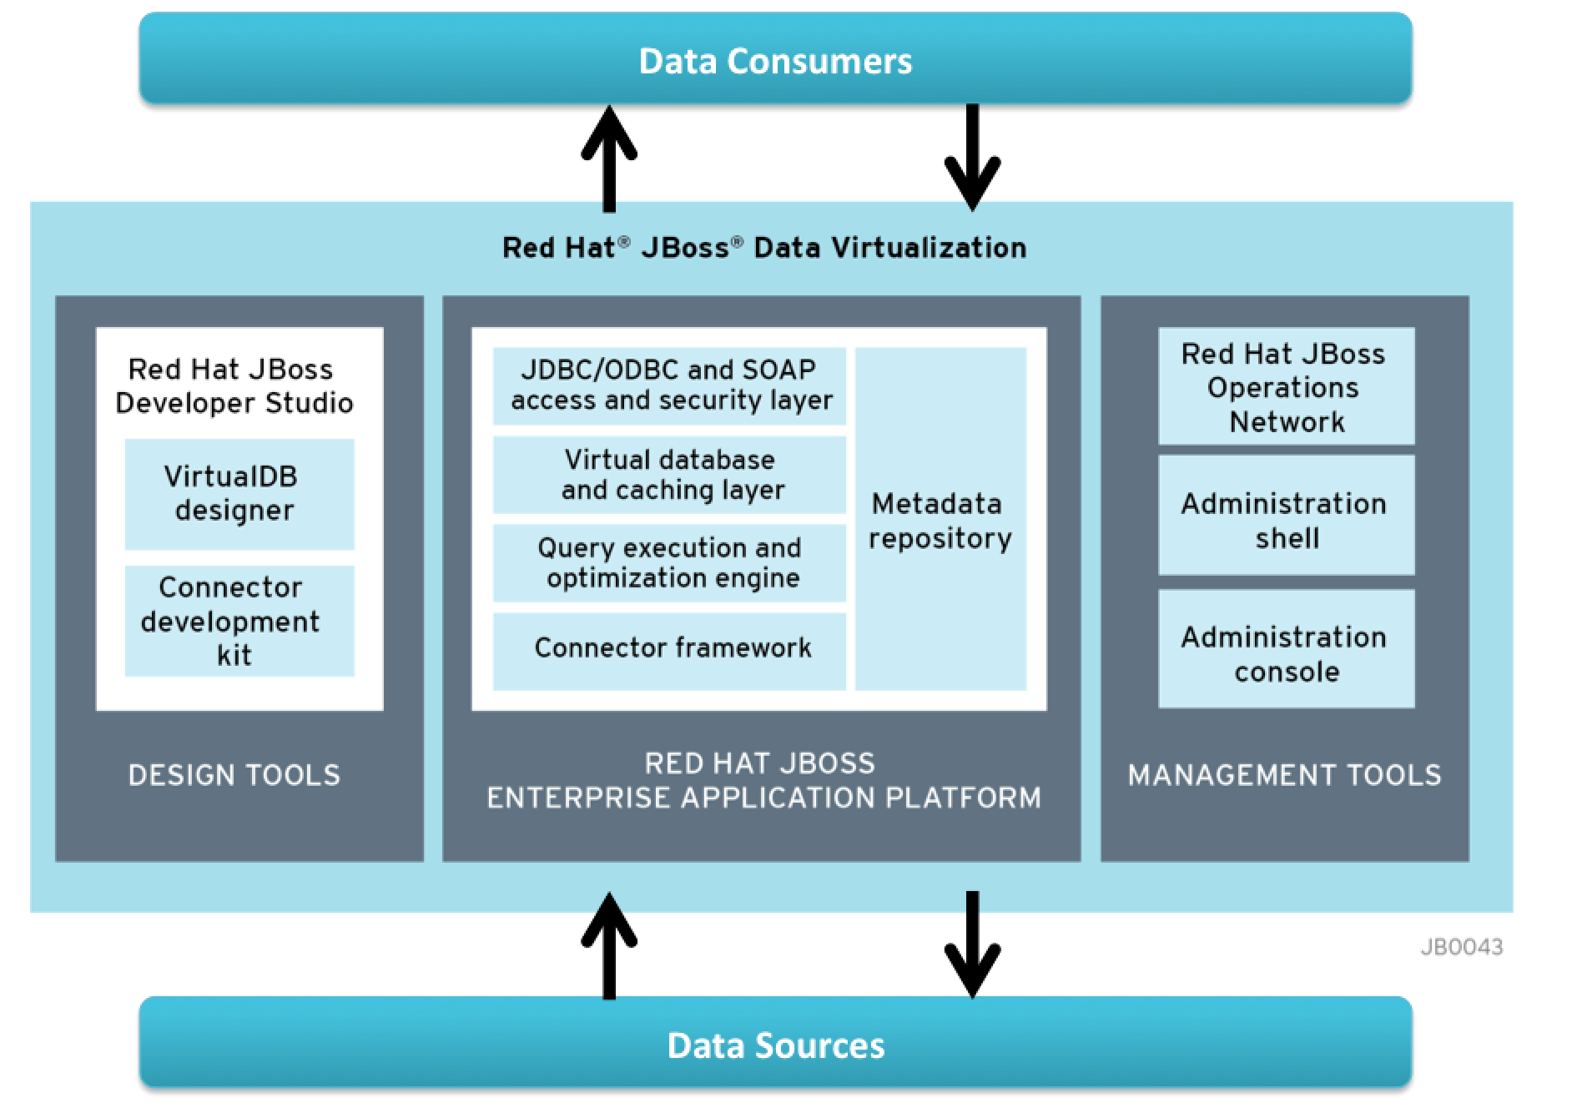
JBoss Data Virtualization Logical Architecture

Slide 6
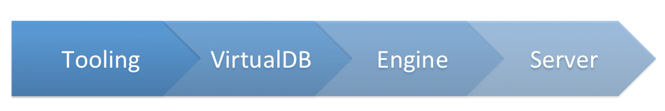
JBoss Data Virtualization System Flow

Slide 7
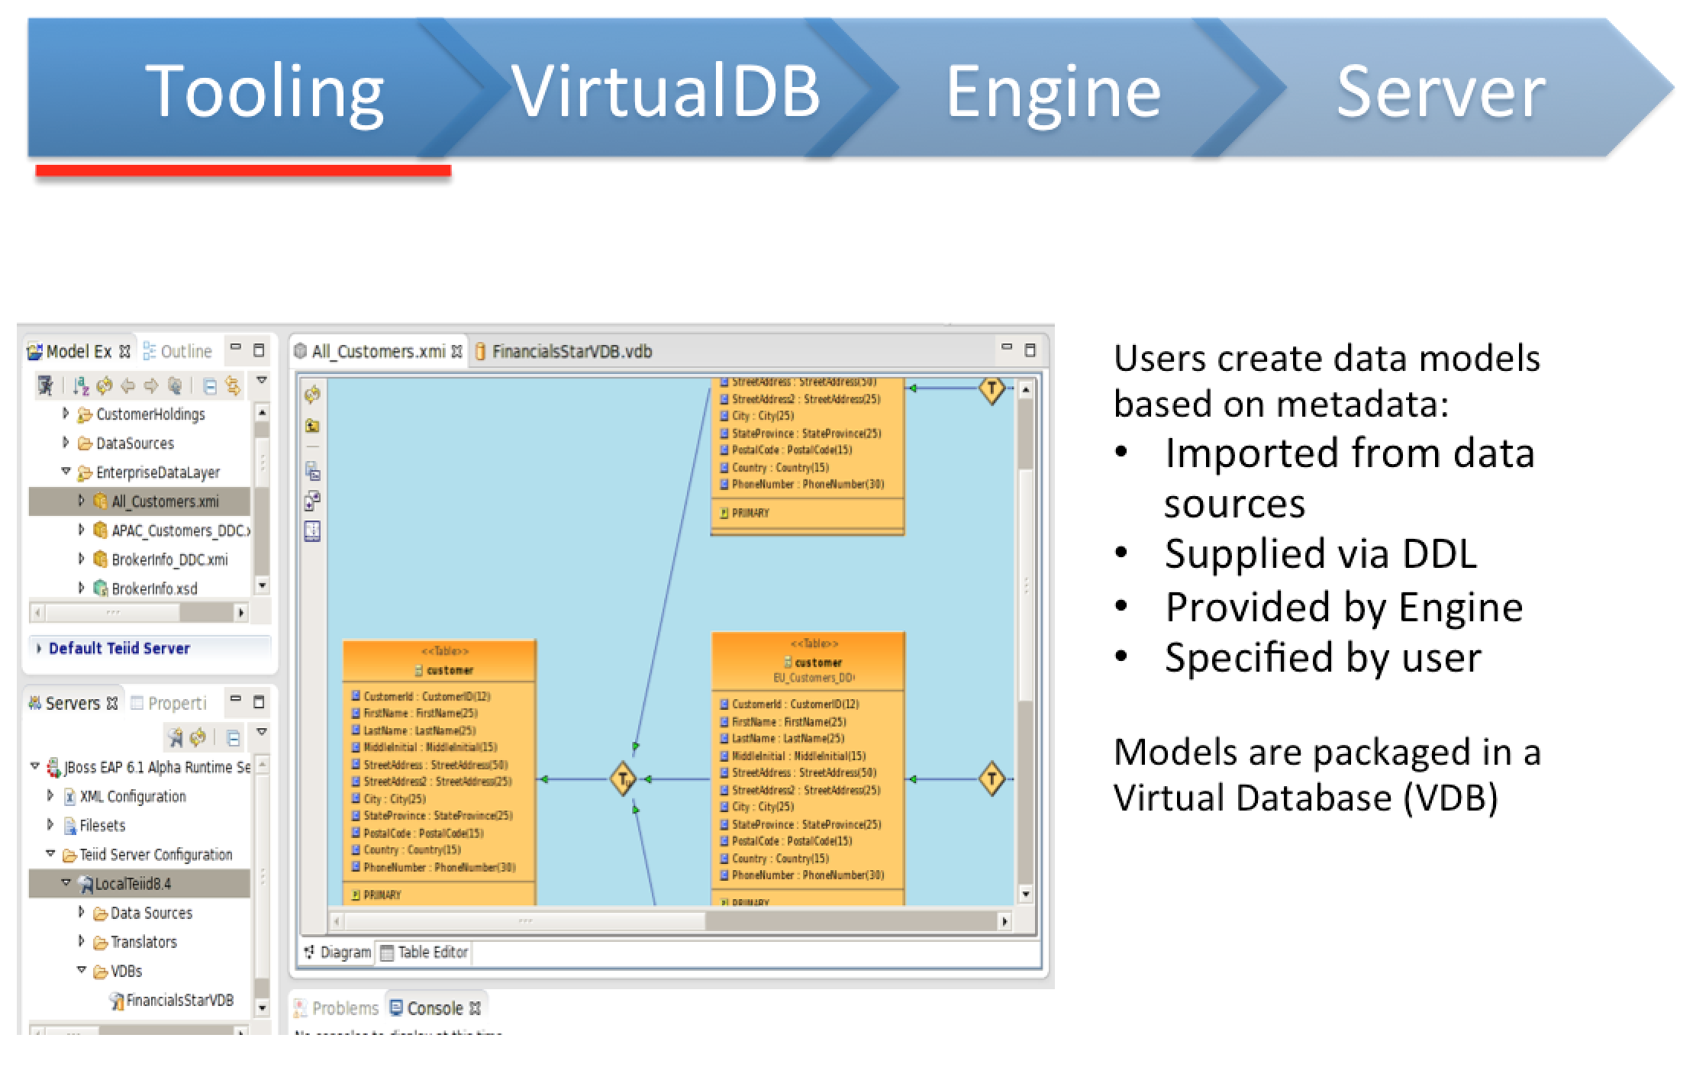
JBoss Data Virtualization System Flow (Cont'd)

Slide 8
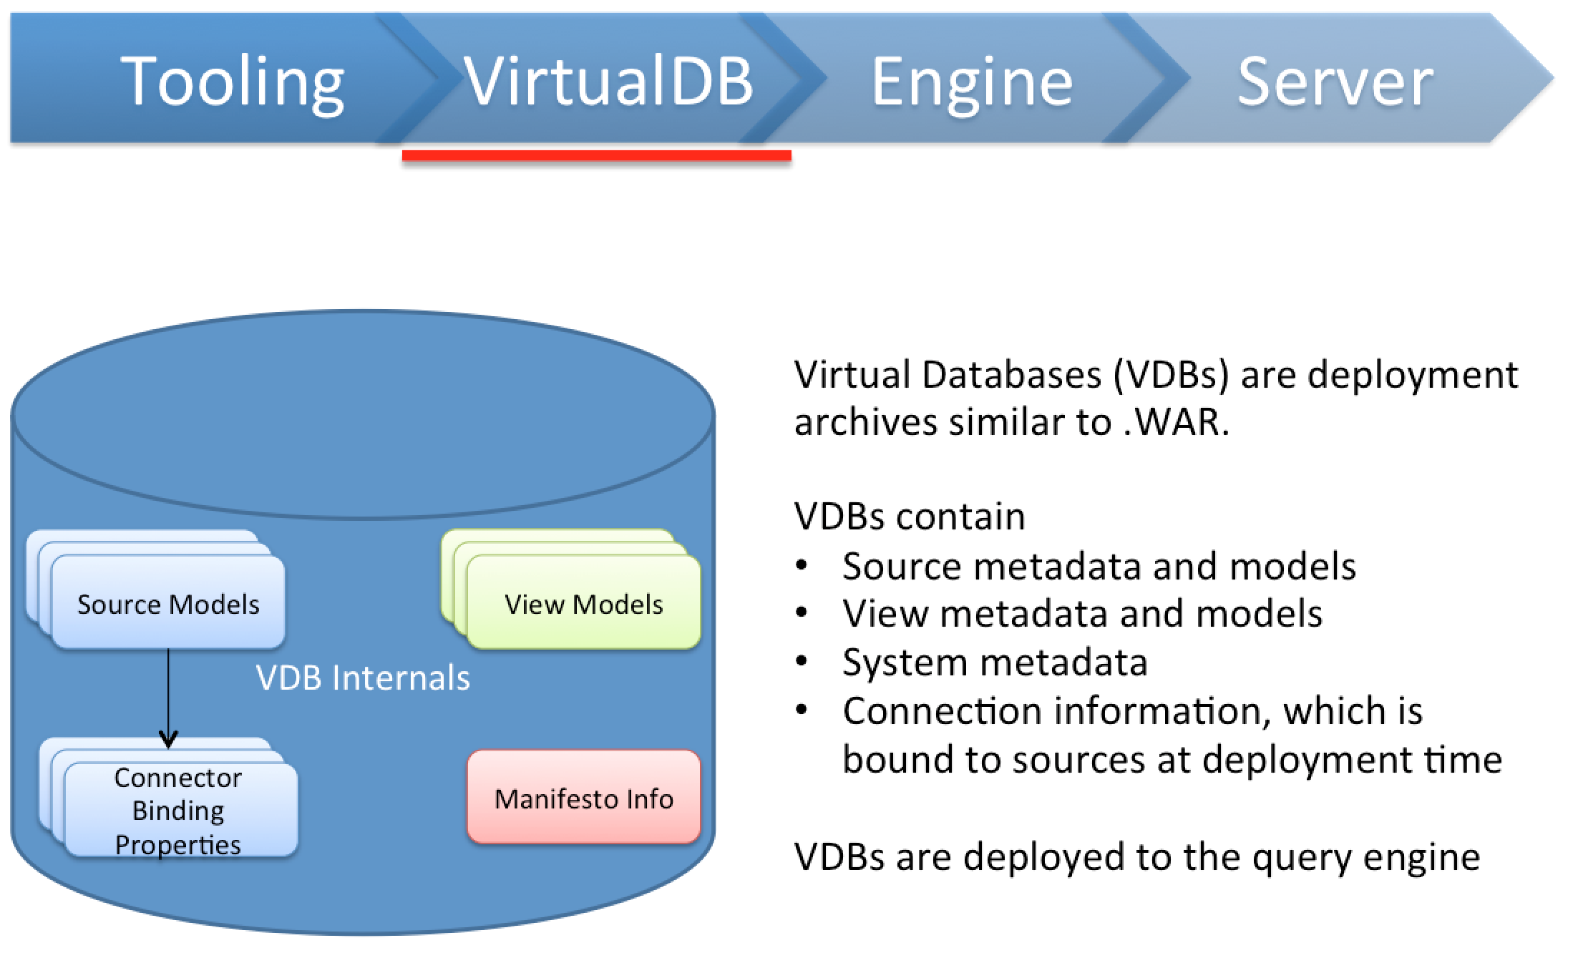
JBoss Data Virtualization System Flow (Cont'd)

Slide 9
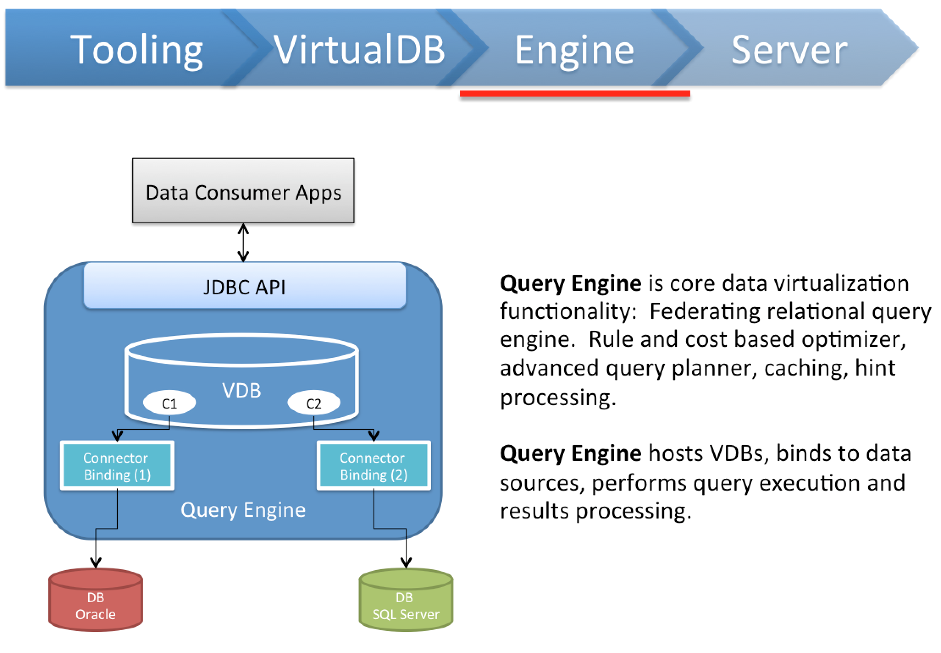
JBoss Data Vitualization System Flow (Cont'd)

Slide 10
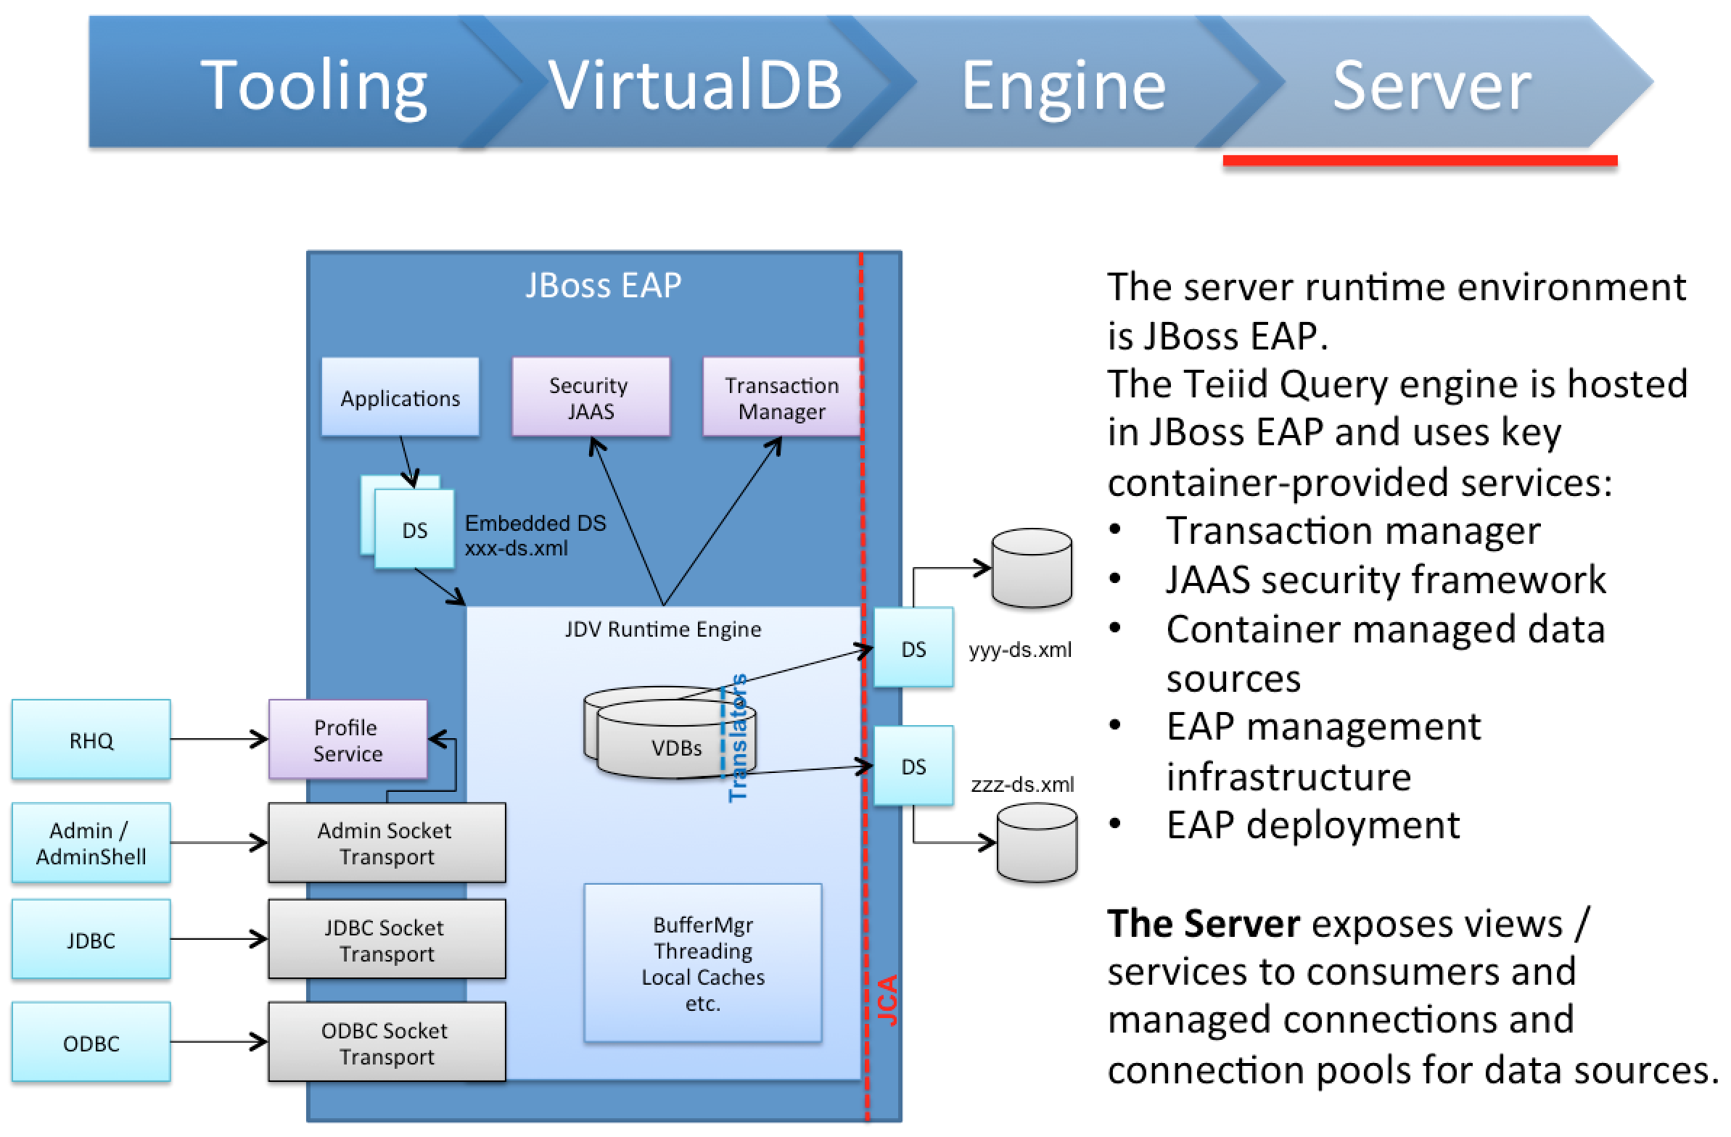
JBoss Data Virtualization System Flow (Cont'd)

Slide 11




Demo Scenario
                Consume
                Compose
                Connect
PostgreSQL Database
with customer data
CSV files
with loyalty data

Slide 12
Call to action
Red Hat JBoss Data Virtualization information
http://www.redhat.com/en/technologies/jboss-middleware/data-virtualization
Red Hat Customer Portal
http://access.redhat.com
Blog
http://teiid.blogspot.com
http://www.ossmentor.com/
JBoss Data Virtualization Workshop
https://github.com/DataVirtualizationByExample/DVWorkshop
IRC: #teiid, #teiiddesigner

Slide 13
Red Hat JBoss Fuse with Integrated Demonstration

Slide 14
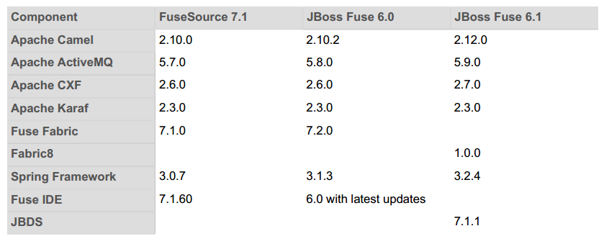
Introducing Red Hat JBoss Fuse

Slide 15
Apache Karaf 2.3
Apache Karaf is a small OSGi based runtime which provides a lightweight container onto which various components and applications can be deployed
Supports the latest OSGi 4.3 containers: Apache Felix Framework 4.0 and Eclipse Equinox 3.8

Slide 16
Apache Camel 2.12
Implementation framework for most commonly used Enterprise Integration Patterns (EIP)
Speeds time to solution and provides multiple connectivity options
Popular and vibrant community
Requirement for a really simple way to do integration
  Started as a Sub-project of ActiveMQ in March 2007
  36 committers (15 work for Red Hat)
  80-100k artifact downloads a month
  120k website views a month
  1000 user mailing list posts per month
  200+ connectors and growing
  Most widely used integration framework

Slide 17
Apache Camel 2.12
Intergration framework based on Enterprise Integration Patterns http://camel.apache.org/enterprise-integration-patterns.html
Routing and Mediation Rules can be defined in Domain-Specific Languages (DSL) including Java-based Fluent API, Spring or Blueprint XML Configuration Files and Scala DSL
Provides support for Bean Binding and seamless integration with frameworks such as Spring, Blueprint and Guice
Extensive component implementations via URIs http://camel.apache.org/components.html

Slide 18
Apache ActiveMQ 5.9
Open source messaging and Integration Patterns server
Full support of EIP via the Apache Camel Library http://activemq.apache.org/enterprise-integration-patterns.html
Supports JMS 1.1, J2EE 1.4 and JCA 1.5
Multiple Language Clients and Protocols Supported http://activemq.apache.org/cross-language-clients.html
AMQP and MQTT Support

Slide 19
Apache CXF 2.7
Apache CXF is an open source services framework. CXF helps you build and develop services using frontend programming APIs, like JAX-WS and JAX-RS.
These services can speak a variety of protocols such as SOAP, XML/HTTP, RESTful HTTP, or CORBA and work over a variety of transports such as HTTP, JMS or JBI

Slide 20
Advantages of DV and Fuse together
Exposing Aggregated Data services to an integration platform
Multiple components and flexibility with Camel
Integration with Camel on multiple platforms

Slide 21
Fuse and Data Virtualization Use Case
                Consume
                Compose
                Connect
PostgreSQL Database
with customer data
CSV files
with loyalty data

Slide 22
Working with Databases with Camel
JDBC component - Allows you to access JDBC APIs from a Camel route. Producer Only
SQL component - Allows you to write SQL statements directly into the URI of the component for utilizing simple queries. Consumer and Producer.
JPA component - Persists Java objects to a relational database using the Java Persistence Architecture.
Hibernate component - Persists Java objects using the Hibernate framework. Camel-extras project on Google.
MyBatis component - Allows you to map Java objects to relational databases.
Olingo2 Component - interact with OData 2.0 and 3.0 compliant services

Slide 23
Apache Camel JDBC
URI Format – jdbc:dataSourceName[?options]
Producer Only (not in from() statement)
Standard JDBC API
SQL queries and operations in message body

Slide 24
Apache Camel SQL
Based on spring-jdbc
can create both consumer (e.g. from()) and producer endpoints (e.g. to()).
Supports a JDBC based repository for the Idempotent Consumer EIP pattern. filter out duplicate messages.
Supports a JDBC based repository for the Aggregator EIP pattern. combine a number of messages together into a single message
SQL sent in the URI

Slide 25
Apache Camel Olingo2
Available as of Camel 2.14
The Olingo2 component utilizes Apache Olingo version 2.0 APIs to interact with OData 2.0 and 3.0 compliant services
URI Format – olingo2://endpoint/<resource-path>?[options]
Will be part of JBoss Fuse 6.2
Easy integration with Data Virtualization

Slide 26
Data Virtualization and Olingo2 Demo
Highlights upcoming component
Uses MySQL database with Book and Author database from Odata Teiid blog
JBDS with Data Virtualization externally managed server
Cloned and installed https://github.com/apache/camel/tree/master/components

